Slide 1

Welcome to Year 4

Slide 2
Year Group | Class Numbers | Teachers
Foundation 0 and 1 | F0/F1 | Mrs Lambley and Miss Smith
Foundation 2 | F2 | Miss Shuttleworth (whilst Miss Baker is on maternity leave)
Year 1 | Class 1 | Miss Gibbs
Year 2 | Class 2 | Mrs Blach
Year 3 | Class 3 | Miss Bingley
Year 4 | Class 4 | Miss Kefallinos
Year 5 | Class 5 | Mrs Satterlee
Year 6 | Class 6 | Mrs Richmond
Other Teaching Staff: | Mrs Stone – Cover Teacher Mrs Moran – Cover Teaching Assistant Mrs Moore – Teaching Assistant Mrs Machin - Teaching Assistant Miss Gall – Teaching Assistant Mr Lindley – Teaching Assistant and Sports Teacher

Slide 3
Entering and Leaving School
All children come into school through the main playground and go in through their own classroom door.
Classroom doors open at 8:45am ready for school to start at 8:50a.m.
All children enter school in the morning on their own.
All children finish school at 3:20p.m. and are collected from their own classroom door.
Children from our classes are not permitted to walk home alone.
If your child is being collected by someone they are not normally collected by, please let teachers or the office know before the end of the day.

Slide 4
Communication
Teachers will be at their classroom doors at the start and end of each day for any quick concerns or information you wish to share – please be aware that this can be a busy time.
Text and phone messages, via the school office, can also get passed onto class teachers if needed.
For a longer chat, please contact the school office to make an appointment for us to contact you by telephone.
You can also contact class teachers directly by email. Please be aware that we only access these when possible during school hours. My email addresses is:
  mkefallinos@heathlands.notts.sch.uk

Slide 5
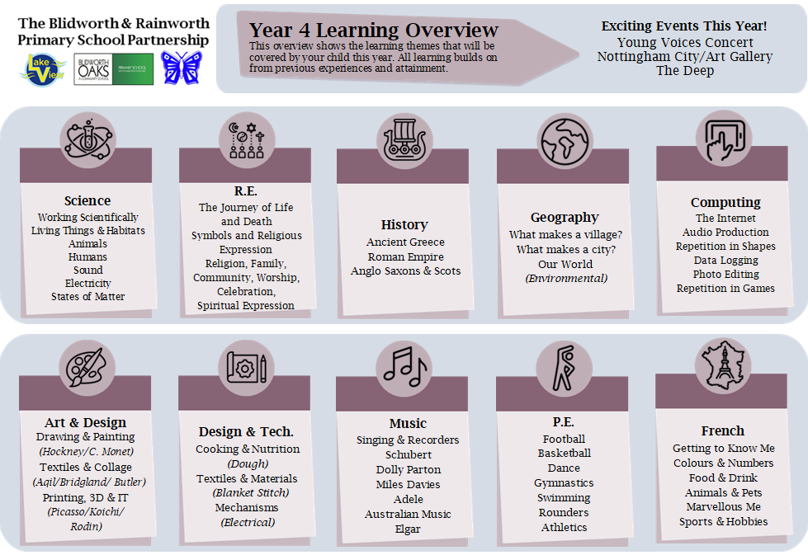
Year 4 Learning Overview

Slide 6
RSHE (Relationship, Sex & Health Education)
The following RSHE topics are taught to each year group in an age appropriate way:
  Families & People who Care for Me
  Caring Friendships
  Respectful Relationships
  Online Relationships
  Being Safe
  Mental Wellbeing
  Internet Safety and Harms
  Physical Health and Fitness
  Healthy Eating
  Drugs, Alcohol and Tobacco
  Health and Prevention
  First Aid
  Changing Adolescent Body
  Sex Education (Year 6 only)

Slide 7
RSHE (Relationship, Sex & Health Education)
All parts of RSHE, except the Sex Education, are compulsory for Primary age children. Further information about the full RSHE content for Year 4 can be found further below.
RSHE is taught across our whole curriculum and across the whole school year, including on Values Days.
If you have any concerns about any aspects of RSHE learning, please speak to me or Mrs Morgan.

Slide 8

High 5 Reward
The Heathlands High 5 is our way of celebrating children who fully embrace school life by: coming to school every day, regularly practicing reading, earning lots of Value Points, wearing the correct uniform and regularly completing homework.
Children get three opportunities per year to earn this reward, and all children who succeed are invited to a special reward event, such as inflatables, a movie afternoon or a water fight!

Slide 9

Reading Challenge
Children are encouraged to ‘Go for Gold’ and read at least 50 times each term with the aim of reading a school reading book at home at least four times a week.
‘Reads’ simply need to be ticked off in the ‘School Book’ section of our Reading Diaries; comments do not have to be made every day.
Extra ‘reads’ can be earned each day by reading other texts such as story books, information books, comics or magazines from home, or Read for Pleasure books from school. These ‘reads’ need to be ticked in the ‘Read for Pleasure’ section of Reading Diaries.

Slide 10
Homework in Year 4
Weekly spelling
Times Tables Rockstars (TTRs)

Slide 11
Attendance
Good attendance is considered 96% or above.
To earn the High 5 Reward each term requires no more than two days of authorised absence (no holidays).
Trust us to look after your child, even when they might be feeling a little unwell, we will always call if we feel they need to go home.
Staff can also administer medicine to children with parental permission.

Slide 12
Attendance
Remember term time holidays will not be authorised unless there are exceptional circumstances and you may be fined per parent, per child.
Being on time is also important, children start learning within five minutes of entering school!
Further information about attendance and lateness and how we can support you as a school can be found below.

Slide 13
School Uniform
Royal blue jumper, cardigan or fleece
(with or without school logo)
White or blue polo shirt or school shirt
Grey, black or navy trousers, shorts, skirt or dress
Fully black footwear
Blue and white check dress as an option for summer weather

Slide 14
School Uniform
PE Kit
  White t-shirt
  Black or blue shorts or jogging bottoms
  Trainers or plimsolls
All uniform with the HPS logo on can be purchased online at: https://myclothing.com/heathlands-primary-school/5935.school
Full uniform, including black footwear, and full school PE kit must be worn every day to earn the High 5 Reward.

Slide 15
Values
Children earn Value Points from all adults within school by demonstrating any of our school Values in their learning or behaviour.
Every Value Point awarded is recorded and goes towards individual and House Team totals.
Children need to earn 40 or more Value Points per term to earn the High 5 Reward.

Slide 16
Other Key Information
Children in Y3, Y4, Y5 and Y6 may bring in their own healthy snack for playtime.
The school council run a Tuck Shop every Friday selling healthy snacks for 50p each.
In Y3, Y4, Y5 and Y6 children bring their own water bottles and take them home daily to be cleaned and refilled.

Slide 17
Other Key Information
Children will need to bring from home their own book bag to transport their books and Home School Diary to school everyday.
Please write your child’s name in all pieces of uniform and personal belongings.
School provide all pencils, pens, felt tips, etc.

Slide 18
Other Key Information
We encourage children to be resilient with minor injuries and accidents that do not involve blood or an impact to the head.
This means you may not get notified of every accident in school if your child does not need direct First Aid. However, if your child has a specific medical need that requires us to be extra vigilant, please let us know.
We use an online paperless ‘bump note’ system, you will receive an email with details of any first aid your child has had.

Slide 19
Other Key Information
PE will be swimming on Thursday afternoons- further details will be sent separately

Slide 20
Parental Involvement
Weekly Celebration Assemblies each Friday at 9:10a.m. in the hall - parents/ carers will receive an invitation if their child is up for an award.
Termly ‘Seeing is Believing’ events & productions
Termly Parent Meetings & Learning Celebrations (TLCs) – W/B 15th September 2025
Support with trips and visits (DBS paid by school)
Reading Volunteers – please ask for more information!
Donations of unwanted books and toys always appreciated.

Slide 21
See you on
Thursday 4th September 2025!

Slide 22
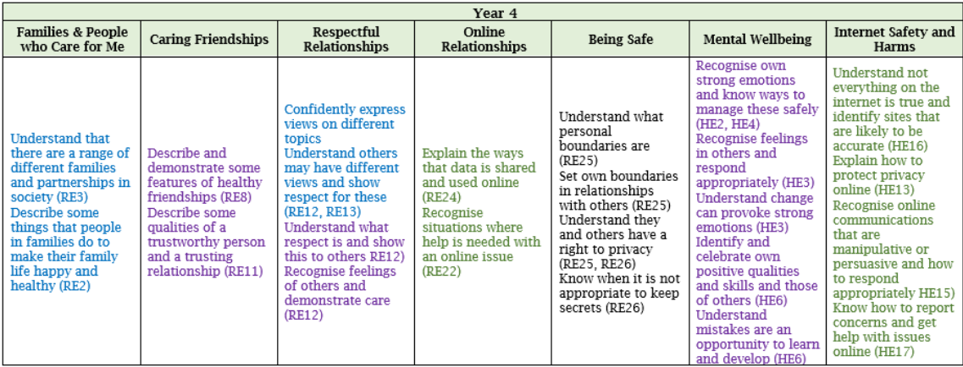
Year 4 RSHE Further Information

Slide 23
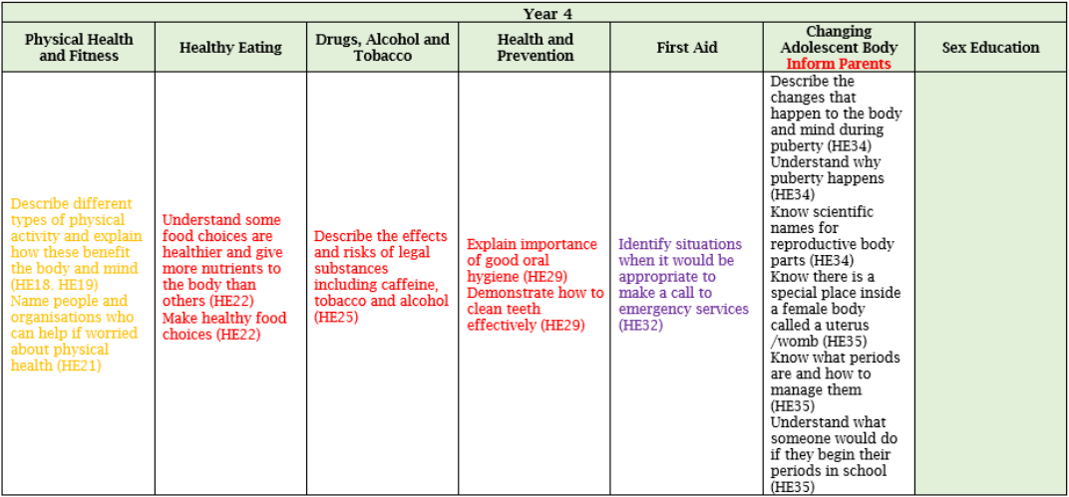
Year 4 RSHE Further Information

Slide 24
Attendance Further Information
There are 365 days in a year. We only spend 190 days at school, leaving 175 days for families to: go on holiday, have days out, go shopping or attend non-urgent medical appointments.
It only takes 8 days absence over a school year to put your child’s attendance below 96%.
It only takes 19 days absence over a school year for your child to be classed by the Government as Persistently Absent at below 90%.
Some absences are unavoidable. We understand that children will get sick and need to stay home occasionally. The important thing is to get your child to school as often as possible.

Slide 25
Attendance Further Information
Use the Gateway APP to keep track of your child’s attendance.
Speak to us if you are having any particular issues with your child’s health or getting them to school, we may be able to help.
Try to make any necessary medical appointments during term time for after school, or at the earliest after 1.30pm so your child still gets their mark.
Speak to a member of staff if you are unsure about how soon a child can return to school after an illness. You know your child, if you feel they are well enough to come then send them in!

Slide 26
Lateness Further Information
Being just 5 minutes late a day loses the equivalent of 3 days of learning a year.
Being 15 minutes late each day is the same as missing two weeks of school.
Children arriving after 9.00am will need to enter through the school office and will be registered as late.
Children arriving after 9.20am are considered significantly late, and will be registered as an unauthorised absence.

