Slide 1

Welcome to Foundation Stage 2

Slide 2
Mr Walker – Executive Head Teacher of Lake View, Blidworth Oaks and Heathlands
Mrs Morgan – Head of School
Miss Baker– Foundation Stage Leader (currently on maternity leave)
Miss Smith and Mrs Lambley – FS1 & FS0
Miss Shuttleworth – F2 Class Teacher

Slide 3
Year Group | Class Numbers | Teachers
Foundation 0 and 1 | F0/F1 | Mrs Lambley and Miss Smith
Foundation 2 | F2 | Miss Shuttleworth (whilst Miss Baker is on maternity leave)
Year 1 | Class 1 | Miss Gibbs
Year 2 | Class 2 | Mrs Blach
Year 3 | Class 3 | Miss Bingley
Year 4 | Class 4 | Miss Kefallinos
Year 5 | Class 5 | Mrs Satterlee
Year 6 | Class 6 | Mrs Richmond
Other Teaching Staff: | Mrs Stone – Cover Teacher Mrs Moran – Cover Teaching Assistant Mrs Moore – Teaching Assistant Mrs Machin - Teaching Assistant Miss Gall – Teaching Assistant Mr Lindley – Teaching Assistant and Sports Teacher

Slide 4
Communication
Teachers will be at their classroom doors at the start and end of each day for any quick concerns or information you wish to share – please be aware that this can be a busy time.
Text and phone messages, via the school office, can also get passed onto class teachers if needed.
For a longer chat, please contact the school office to make an appointment for us to contact you by telephone.
Email - rshuttleworth@heathlands.notts.sch.uk

Slide 5
The Foundation Stage Curriculum

Slide 6
Areas of Learning
-Personal, Social and Emotional Development.
-Communication and Language
-Physical Development
-Mathematics
-Literacy
-Expressive Arts and Design
-Understanding The World
Prime Areas
Specific Areas

Slide 7
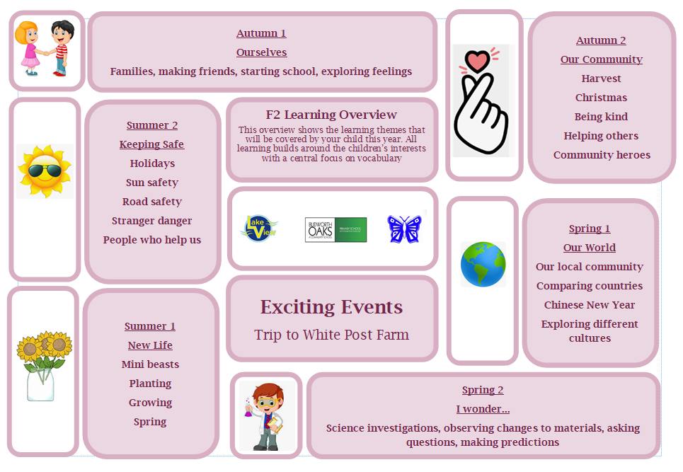

Slide 8

Assessment & Progress Meetings
Initial entry assessments – WellComm (language) and Government Baseline
Ongoing assessments through observations
TLC (parent meetings) each term
Online Learning Journeys (Tapestry)
End of FS2 Assessment (Written Report)

Slide 9
Early Learning Goals
Word Reading | Comprehension | Writing | Number | Numerical Patterns
Say a sound for each letter in the alphabet and at least 10 digraphs. | Anticipate (where appropriate) key events in stories. | Write recognisable letters, most of which are correctly formed. | Have a deep understanding of number to 10, including the composition of each number. | Verbally count beyond 20, recognising the pattern of the counting system.
Read words consistent with their phonic knowledge by sound-blending. | Demonstrate understanding of what has been read to them by retelling stories and narratives using their own words and recently introduced vocabulary. | Spell words by identifying sounds in them and representing the sounds with a letter or letters. | Subitise (recognise quantities without counting) up to 5. | Compare quantities up to 10 in different contexts, recognising when one quantity is greater than, less than or the same as the other quantity.
Read aloud simple sentences and books that are consistent with their phonic knowledge, including some common exception words. | Use and understand recently introduced vocabulary during discussions about stories, non-fiction, rhymes and poems and during role play. | Write simple phrases and sentences that can be read by others. | Automatically recall (without reference to rhymes, counting or other aids) number bonds up to 5 (including subtraction facts) and some number bonds to 10, including double facts. | Explore and represent patterns within numbers up to 10, including evens and odds, double facts and how quantities can be distributed equally.

Slide 10


Reading
School decodable book
Reading for Pleasure book

Slide 11
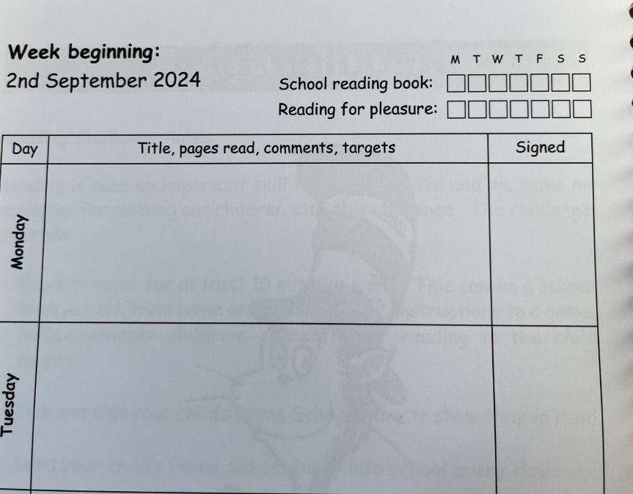

Reading
- The aim is to read a school reading book at home at least four times a week.
- Your child can also read other books that you have at home (story books, comics, magazines, etc.) or Reading for Pleasure books.
Autumn Term – Lilac books
Autumn/Spring Term – Pink books

Slide 12

High 5 Reward
All children who succeed in the High 5 are invited to a special reward event, such as an movie afternoon, inflatables or a water fight!
Children get three opportunities per year to earn this reward.

Slide 13
Reading Challenge
Children are encouraged to ‘Go for Gold’ and read at least 50 times each term with the aim of reading a school reading book at home at least four times a week.
‘Reads’ simply need to be ticked off in the ‘School Book’ section of our Reading Diaries; comments do not have to be made every day.
Extra ‘reads’ can be earned each day by reading other texts such as story books, information books, comics or magazines from home, or Read for Pleasure books from school. These ‘reads’ need to be ticked in the ‘Read for Pleasure’ section of Reading Diaries.

Slide 14
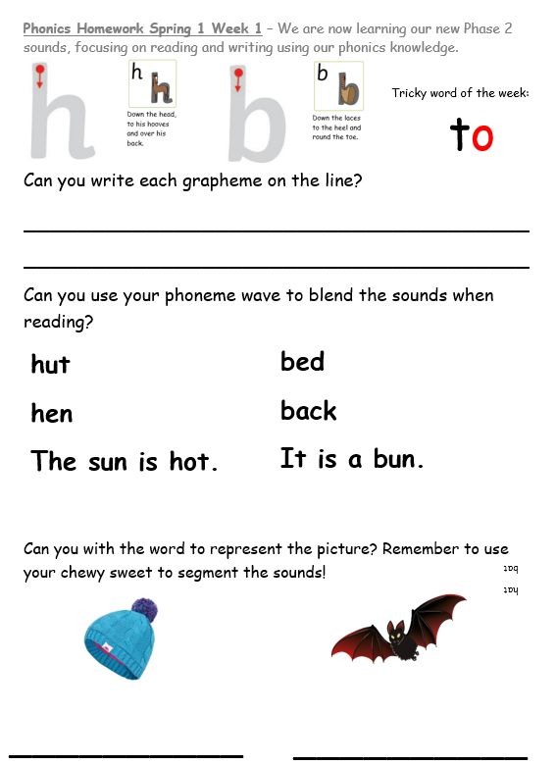
Homework
Your child will receive homework each Friday, this is based on the phonics we have learnt that week.

Slide 15
Attendance
Good attendance is considered 96% or above.
To earn the High 5 Reward each term requires no more than two days of authorised absence (no holidays).
Trust us to look after your child, even when they might be feeling a little unwell, we will always call if we feel they need to go home. Staff can also administer medicine to children with parental permission.

Slide 16
School Uniform
Royal blue jumper, cardigan or fleece
(with or without school logo)
White or blue polo shirt or school shirt
Grey, black or navy trousers, shorts, skirt or dress
Fully black footwear
Blue and white check dress as an option for summer weather

Slide 17
School Uniform
PE Kit (Monday for F2)
  White t-shirt
  Black or blue shorts or jogging bottoms
  Trainers or plimsolls
All uniform with the HPS logo on can be purchased online at: https://myclothing.com/heathlands-primary-school/5935.school
Full uniform, including black footwear, and full school PE kit must be worn every day to earn the High 5 Reward.

Slide 18
Values
Children earn Value Points from all adults within school by demonstrating any of our school Values in their learning or behaviour.
Every Value Point awarded is recorded and goes towards individual and House Team totals.
Children need to earn 40 or more Value Points per term to earn the High 5 Reward.

Slide 19
Entering and Leaving School
All children come into school through the main playground and go in through the Foundation Gate
Classroom doors open at 8:45am ready for school to start at 8:50am
All children enter school in the morning on their own
All children finish school at 3:20p.m. and are collected at the Foundation Gate
If your child is being collected by someone they are not normally collected by, please let teachers or the office know before the end of the day.

Slide 20
Morning Timetable
Enter school
Registration/communication and language task
Phonics
Guided writing in small groups
Snack
Reading for pleasure
Busy time
Outdoor play
Maths
Nursery rhymes
Lunch

Slide 21

Lunchtime
All children are entitled to free school meals.
Packed lunches can be brought into school.
-Dedicated midday supervisors and support from Foundation staff during the first term.
Nut-free and pure egg-free
*letter to follow

Slide 22
Afternoon Timetable
Registration
Reading for pleasure
Topic experience
Busy time
Outdoor play
Drawing club
Snack
Home

Slide 23
Children will need:
- Full school uniform, including fully black shoes.
Please write your child’s name in all pieces of uniform, especially jumpers and cardigans.
- A book bag to transport their books and Reading Diary to school everyday.
- PE Kit – we slowly build up to a full kit change through the first half term (Mondays in F2).
- All uniform with the school logo on can be purchased online at: https://myclothing.com/heathlands-primary-school/5935.school

Slide 24
School will provide
- Pencils, pens, felt tips, ect
- Fruit snack
- Milk until your child’s 5th birthday
- Reusable water bottle.

Slide 25

Medical Tracker
We use an online paperless ‘bump note’ system, you will receive an email with details of any first aid your child has had.
- We encourage children to be resilient, so very minor bumps etc may not be recorded.
- If your child needs further treatment we will call you immediately.

Slide 26
Parent Involvement
Weekly Celebration Assemblies each Friday at 9:10a.m. in the hall - parents/ carers will receive an invitation if their child is up for an award.
Termly ‘Seeing is Believing’ events & productions
Termly Parent Meetings & Learning Celebrations (TLCs)
Support with trips and visits (DBS paid by school)
Reading Volunteers – please ask for more information!
Donations of unwanted books and toys always appreciated.

Slide 27
Breakfast and After School Club
7.30am until 6pm
Breakfast Club – 7.30am – 8.45am £4.50
After School Club
Full session with snack 3.20pm – 6pm £9.50
Part Session with Snack 3.20pm – 4.30pm £7.00
Part Session without Snack 3.20pm – 4.30pm £4.50

Slide 28
Extra Transition Support
We will be offering the following support for children who may need additional transition support:
The opportunity to revisit the school during our INSET day on in order to re-familiarise themselves with the school environment and staff (more info to follow).
Optional phased start in September if you think this would be helpful for your child.

Slide 29
For September…
In order to support your child with their topic work please can you provide…
A family photo (this can be emailed to staff or put on Tapestry)
An object from home that is important to them.
Don’t worry – we will remind you about this again in September!

Slide 30
Useful Contacts
Please don’t hesitate to contact us if you would like to discuss anything to do with your child’s start in F2. You can do this by contacting our school office or emailing us directly.
Heathlands Primary School office
016223 401402
office@heathlands.notts.sch.uk
Miss Shuttleworth - rshuttleworth@heathlands.notts.sch.uk

Slide 31
Let’s play!
See you on
Thursday 4th September 2025!

Slide 32
Attendance Further Information
There are 365 days in a year. We only spend 190 days at school, leaving 175 days for families to: go on holiday, have days out, go shopping or attend non-urgent medical appointments.
It only takes 8 days absence over a school year to put your child’s attendance below 96%.
It only takes 19 days absence over a school year for your child to be classed by the Government as Persistently Absent at below 90%.
Some absences are unavoidable. We understand that children will get sick and need to stay home occasionally. The important thing is to get your child to school as often as possible.

Slide 33
Attendance Further Information
Use the Gateway APP to keep track of your child’s attendance.
Speak to us if you are having any particular issues with your child’s health or getting them to school, we may be able to help.
Try to make any necessary medical appointments during term time for after school, or at the earliest after 1.30pm so your child still gets their mark.
Speak to a member of staff if you are unsure about how soon a child can return to school after an illness. You know your child, if you feel they are well enough to come then send them in!

Slide 34
Lateness Further Information
Being just 5 minutes late a day loses the equivalent of 3 days of learning a year.
Being 15 minutes late each day is the same as missing two weeks of school.
Children arriving after 9.00am will need to enter through the school office and will be registered as late.
Children arriving after 9.20am are considered significantly late, and will be registered as an unauthorised absence.

