Slide 1

Welcome to Foundation Stage 1

Slide 2
Mr Walker – Executive Head Teacher of Lake View, Blidworth Oaks and Heathlands
Mrs Morgan – Head of School
Miss Baker– Foundation Stage Leader (currently on maternity leave)
Mrs Lambley and Miss Smith – FS1 & FS0
Miss Shuttleworth – F2 Class Teacher

Slide 3
Year Group | Class Numbers | Teachers
Foundation 0 and 1 | F0/F1 | Mrs Lambley and Miss Smith
Foundation 2 | F2 | Miss Shuttleworth (whilst Miss Baker is on maternity leave)
Year 1 | Class 1 | Miss Gibbs
Year 2 | Class 2 | Mrs Blach
Year 3 | Class 3 | Miss Bingley
Year 4 | Class 4 | Miss Kefallinos
Year 5 | Class 5 | Mrs Satterlee
Year 6 | Class 6 | Mrs Richmond
Other Teaching Staff: | Mrs Stone – Cover Teacher Mrs Moran – Cover Teaching Assistant Mrs Moore – Teaching Assistant Mrs Machin - Teaching Assistant Miss Gall – Teaching Assistant Mr Lindley – Teaching Assistant and Sports Teacher

Slide 4
The Foundation 1 Sessions
The Early Years Universal Entitlement
All children aged 3 are entitled to this:
15 free hours each week in 3 hour blocks
5 morning or 5 afternoon sessions
    Mornings – 8:50 am to 11:50 am
    Afternoons – 12:20 pm to 3:20 pm

Slide 5
The Foundation 1 Sessions
The Extended Entitlement
(30 Hours)
From September 2017, the government extended the free entitlement for three and four year olds to 30 hours for some children:
Both parents (or the sole parent in a one parent family) need to be working a minimum of 16 hours per week at the national minimum wage.

Slide 6
How to check if you are entitled..
Register and apply directly through the HMRC website
Welcome to GOV.UK (www.gov.uk)
You will receive an ‘eligibility code’ if you are entitled. Bring this to the school office as soon as possible.

Slide 7
Extended Entitlement
How does it work?
Every school or setting is different.
We offer the Extended Entitlement as 4 extra sessions, including lunch time supervision.
For example, a child who has 5 morning sessions would be entitled to an extra 4 afternoon sessions.

Slide 8
Extended Entitlement
Example
 | Mon | Tues | Weds | Thurs | Fri
AM | ☺ | ☺ | ☺ | ☺ | ☺
PM | ☺ | ☺ | ☺ | ☺

Slide 9
Paid Extra Sessions
Sessions are subject to availability – advance booking necessary.
Bookings can be made through the office.
All payments are made using our School Gateway app.
An extra session is charged at £10-£15.

Slide 10
Communication
Teachers will be at their classroom doors at the start and end of each day for any quick concerns or information you wish to share – please be aware that this can be a busy time.
Text and phone messages, via the school office, can also get passed onto class teachers if needed.
For a longer chat, please contact the school office to make an appointment for us to contact you by telephone.
Email -rlambley@heathlands.notts.sch.uk
lauren.smith@heathlands.notts.sch.uk

Slide 11
The Foundation Stage Curriculum

Slide 12
Areas of Learning
-Personal, Social and Emotional Development.
-Communication and Language
-Physical Development
-Mathematics
-Literacy
-Expressive Arts and Design
-Understanding The World
Prime Areas
Specific Areas

Slide 13
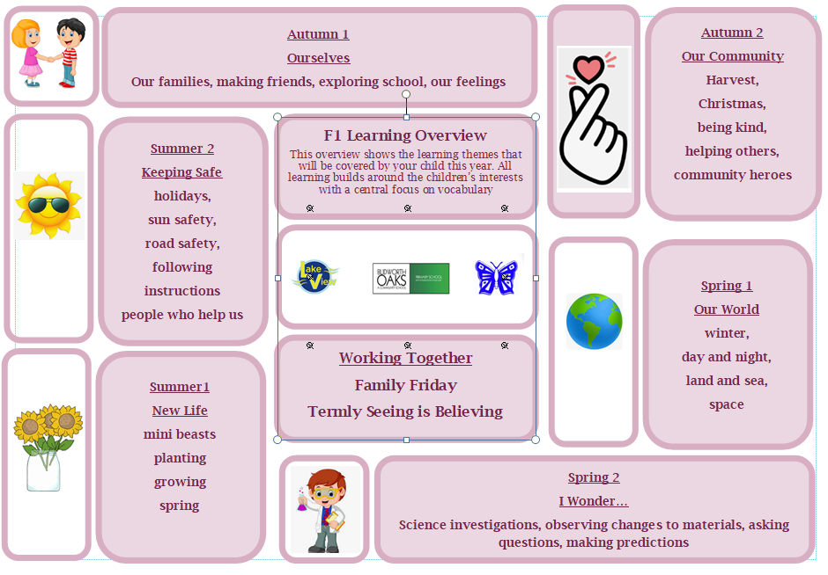

Slide 14
Assessment & Progress Meetings
Initial entry assessments – WellComm (language)
Ongoing assessments through observations
TLC (parent meetings) each term
Online Learning Journeys (Tapestry)

Slide 15

Tapestry
This is an online learning journey – photographs and assessments to share special moments at school and home.
Used to share news and updates.
All we need is your email address and signature.
School office will send you a password to activate the account.

Slide 16
Entering and Leaving School
Morning session is 8:50am. to 11:50am.
Drop-off and collection at the Foundation Gate
Afternoon session is 12:20pm. to 3:20pm.
Drop off at the main office and collection at the Foundation Gate
Please ensure afternoon children have had their lunch before being dropped off
If your child is being collected by someone they are not normally collected by, please let teachers or the office know before the end of the day.

Slide 17
A Typical Sessions
Directed Play
Phonics
Snack
Busy Time
Maths
Singing
Story
Home time
Notes:
Classroom doors open at 8:45am ready for school to start at 8:50a.m.

Slide 18


Big Bake
Every Friday we will ‘bake’ in groups.
Some examples – Fruit cones, apple and sultana muffins, apple and cheese boats.
Very important that we know any dietary requirements.

Slide 19

Lunchtime
School dinners can be paid through the Gateway app
Packed lunches can be brought into school
-Dedicated midday supervisors and support will be provided.
Nut-free and pure egg-free
*letter to follow

Slide 20
Children will need:
- Full school uniform, including fully black shoes.
Please write your child’s name in all pieces of uniform, especially jumpers and cardigans.
- All uniform with the school logo on can be purchased online at: https://myclothing.com/heathlands-primary-school/5935.school
- A book bag to transport their books and Reading Diary to school everyday.
- Change of clothes
- Wellies
- Nappes/wipes if necessary

Slide 21
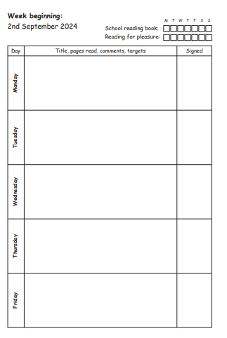
Reading Diary
This is to mark down when you and your child read together.

Slide 22
School will provide:
- Pencils, pens, felt tips, etc
- Fruit snack
- Milk until your child’s 5th birthday
- Reusable water bottle.

Slide 23

Medical Tracker
We use an online paperless ‘bump note’ system, you will receive an email with details of any first aid your child has had.
- We encourage children to be resilient, so very minor bumps etc may not be recorded.
- If your child needs further treatment we will call you immediately.

Slide 24
Breakfast and After School Club
7.30am until 6pm
Breakfast Club – 7.30am – 8.45am £4.50
After School Club
Full session with snack 3.20pm – 6pm £9.50
Part Session with Snack 3.20pm – 4.30pm £7.00
Part Session without Snack 3.20pm – 4.30pm £4.50
Booking should be made in advance.

Slide 25
For September…
In order to support your child with their topic work please can you provide…
A family photo (this can be emailed to staff or put on Tapestry)
An object from home that is important to them.
Don’t worry – we will remind you about this again in September!

Slide 26
Extra Transition Support
We will be offering the following support for children who may need additional transition support:
The opportunity to revisit the school during our INSET day on in order to re-familiarise themselves with the school environment and staff (more info to follow).

Slide 27
Useful Contacts
Please don’t hesitate to contact us if you would like to discuss anything to do with your child’s start in Foundation. You can do this by contacting our school office or emailing us directly.
Heathlands Primary School office
01623 401402
office@heathlands.notts.sch.uk
rlambley@heathlands.notts.sch.uk
lauren.smith@heathlands.notts.sch.uk

Slide 28
See you on
Thursday 4th September 2025!

